Slide 1
Small Project 1

Slide 2
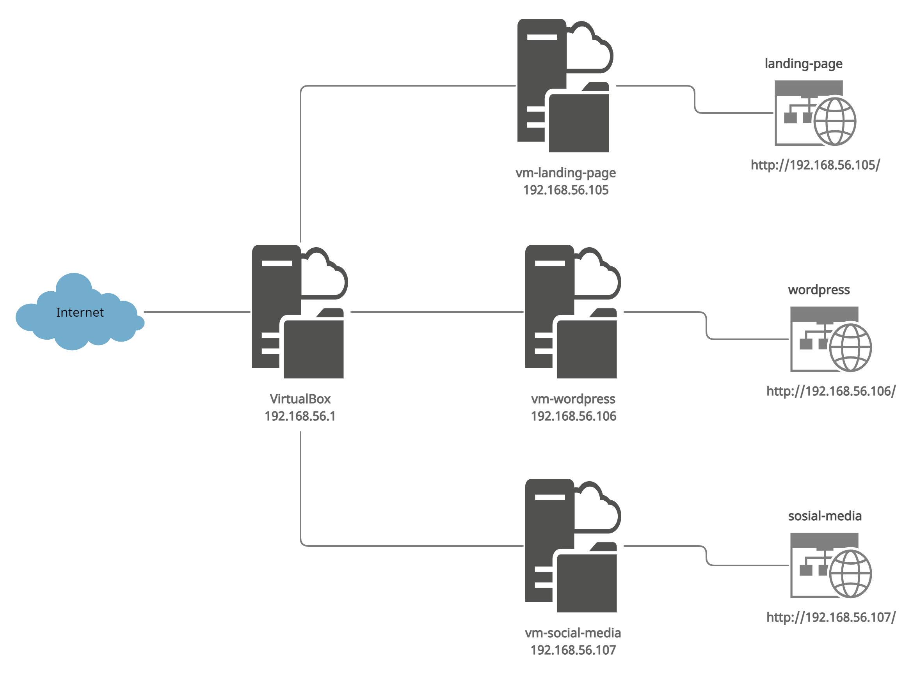
Topologi infrastruktur

Slide 3

vagrantfile

Slide 4

vagrantfile

Slide 5

vagrantfile

Slide 6
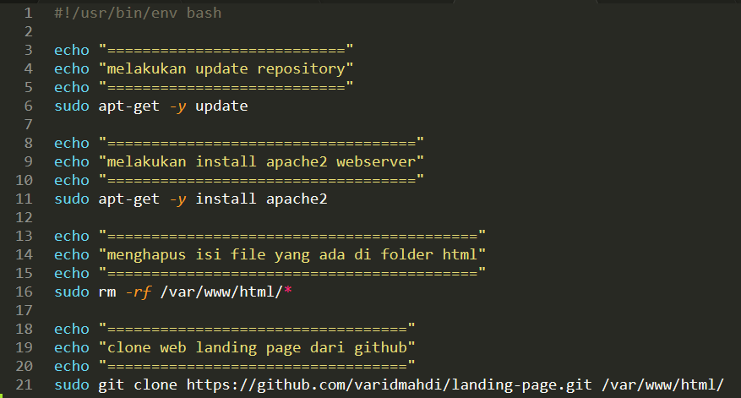
Langing-page.sh

Slide 7
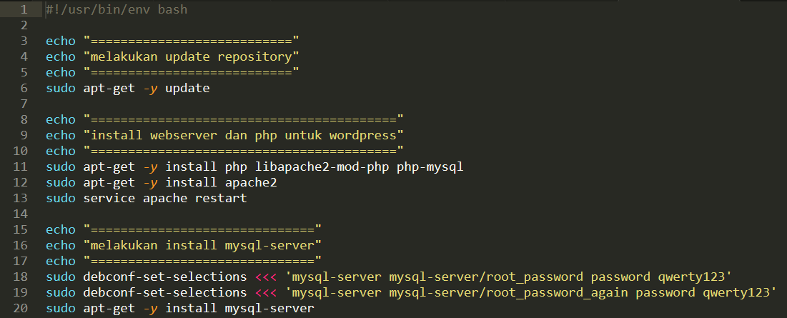
Wordpress.sh

Slide 8
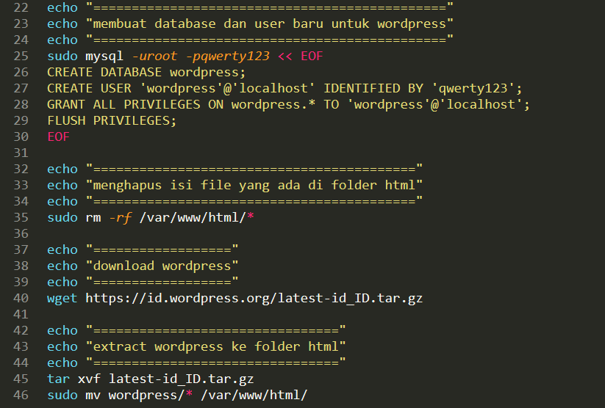

Slide 9
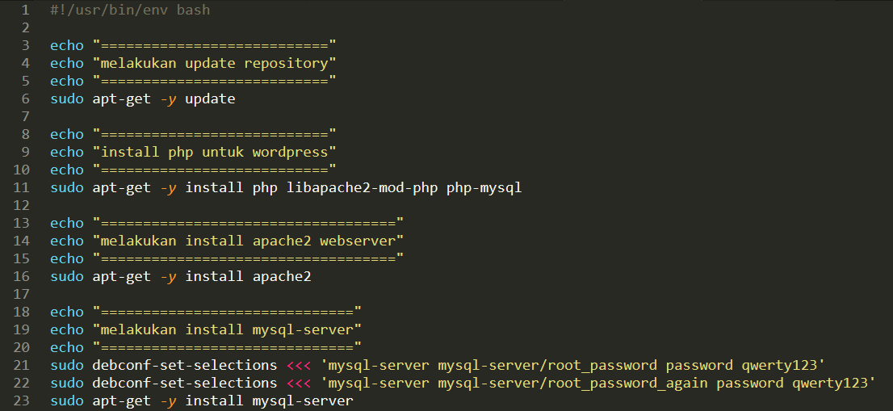
Social-media.sh

Slide 10
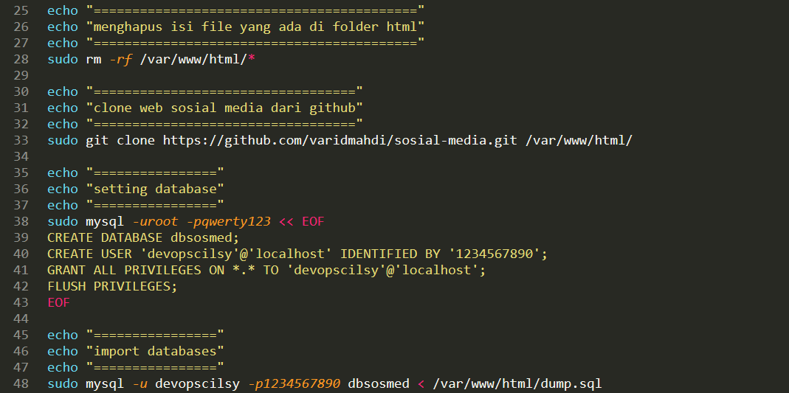

Slide 11
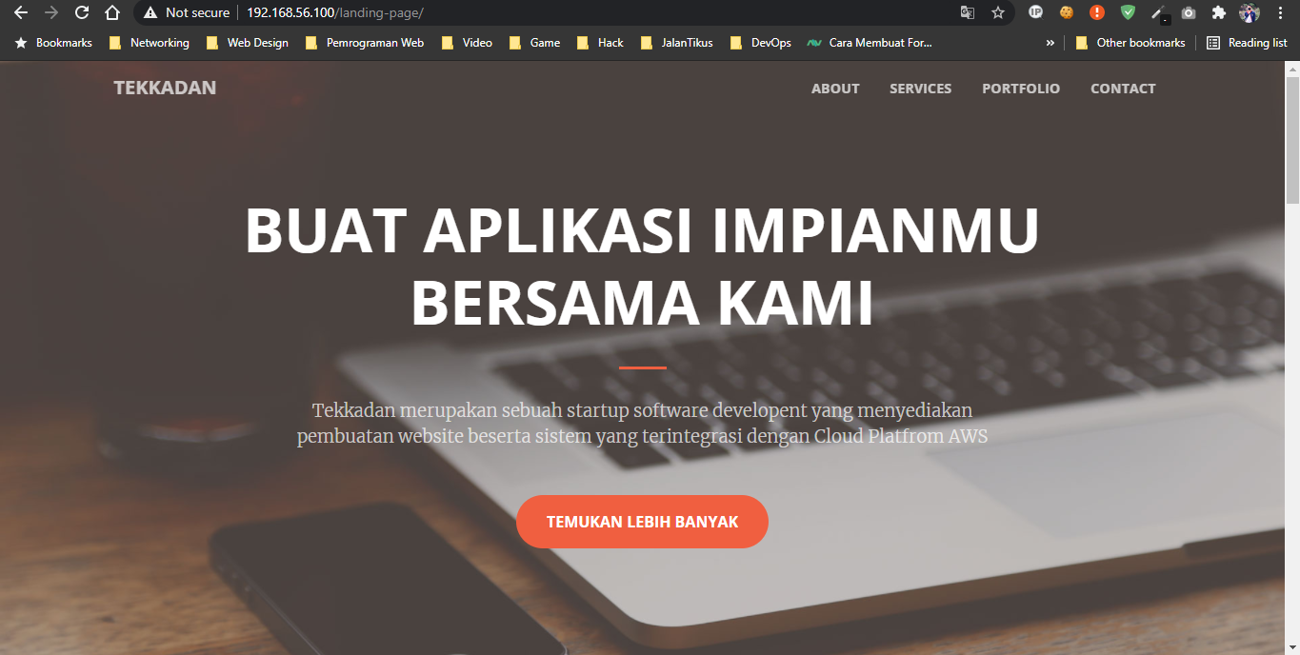
Website landing page

Slide 12
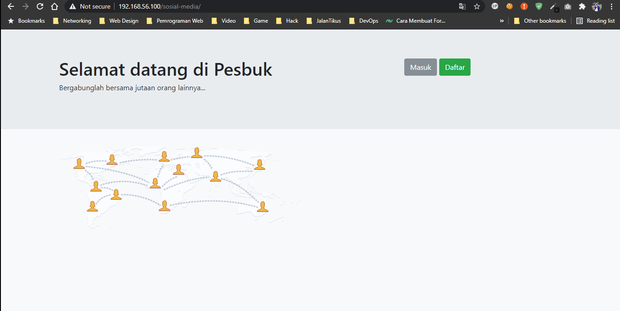
Website pesbuk

Slide 13
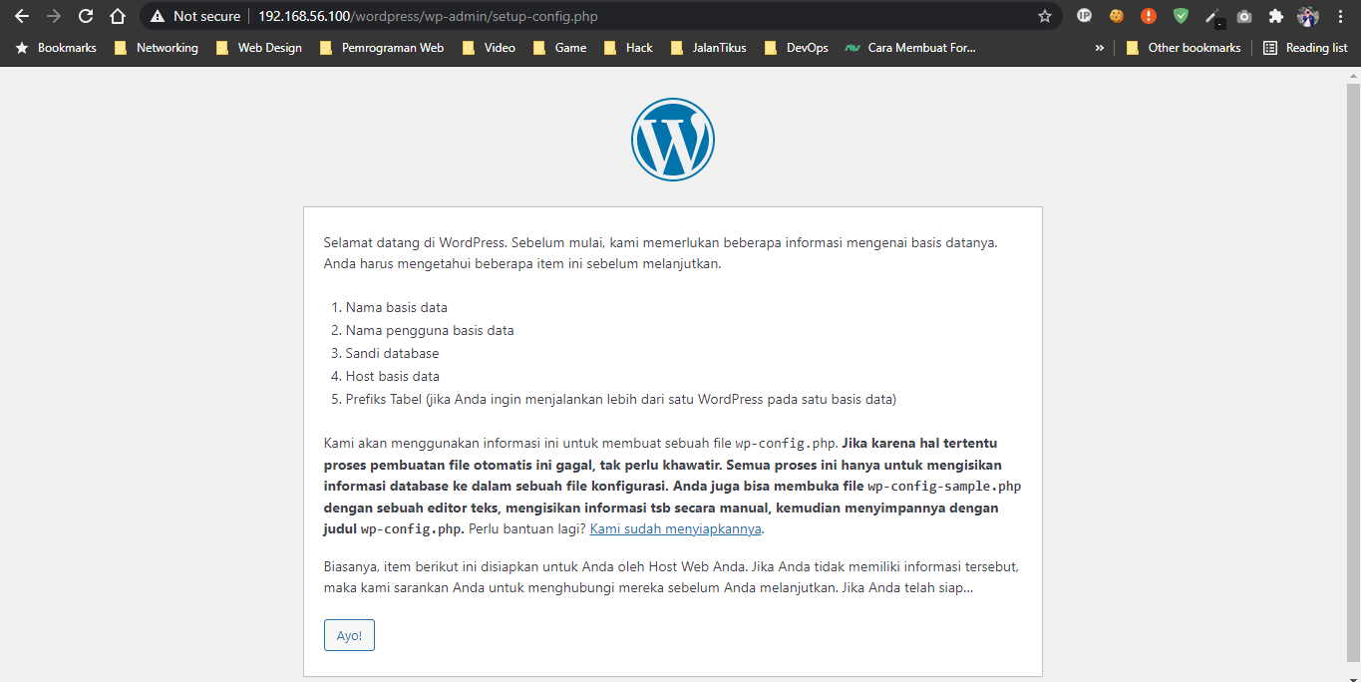
Website wordpress

